Slide 1


Siamese Networks and Image Verification
Emanuele Alessi
Gianmarco Forcella
Taranciuc Gabriel

Slide 2
Training our Siamese Network
From dataset to training data and the training process

Slide 3
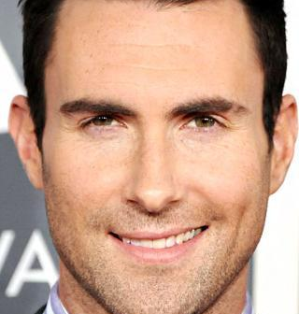
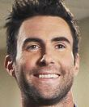
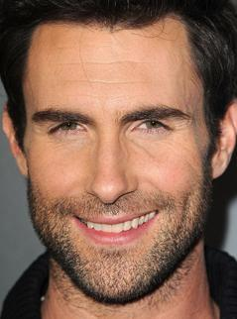
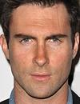
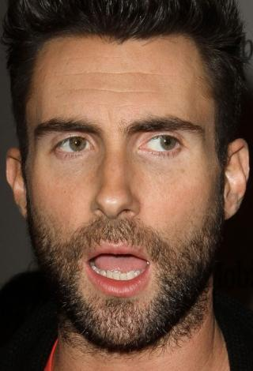
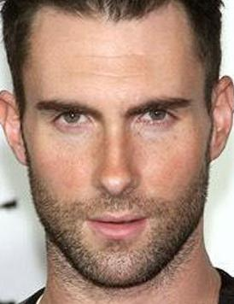
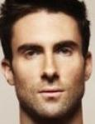
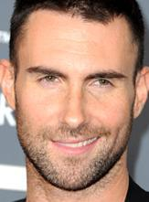
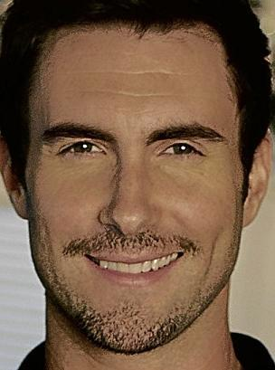
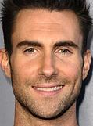


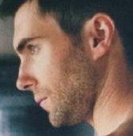
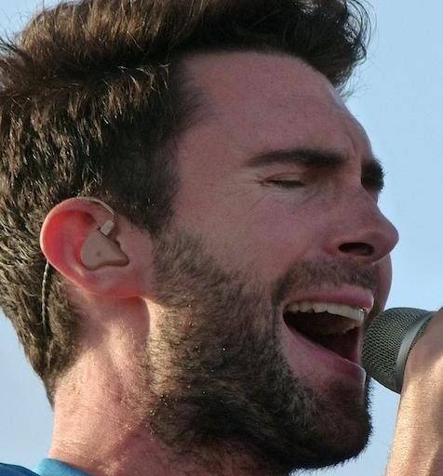
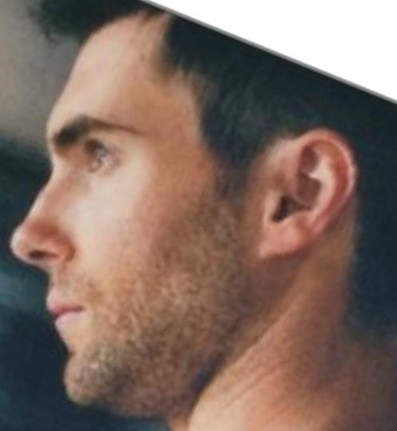
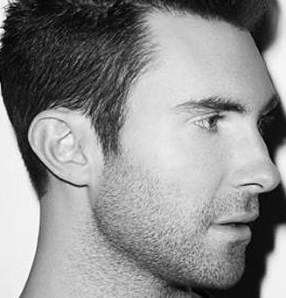
The CFPW Dataset
A dataset of 500 celebrities; 14 photos of each, 10 from the front, 4 from the side.
Different sizes, different aspect ratios, different lighting and different expressions.
For our purposes, we chose to only use the frontal facing images.

Slide 4
Loading and splitting
All 10 frontal images are loaded in RGB through PIL
Images are resized through the LANCZOS technique to 105x105
We randomly select 70% of the images of each celebrity for training, and use the remainder for testing

Slide 5
Training through TensorFlow
All images are converted to NumPy arrays of size 105x105x3 for TensorFlow support
At each iteration, the network takes a training batch of 32 pairs of images from the train set
16 “true” pairings
16 “false” pairings
Goal is to minimize loss → the Adam Optimizer
Notes:
Why Adam:
It is easy to implement;
It is computationally efficient;
It requires a small amount of memory;
It is invariant to the diagonal rescale of gradients.

Slide 6
Accuracy testing while training
Every 500 steps
Support set of 10 pairings from the test set
1 “true pairing”
9 “false” pairings
Check if it guessed the “true” pairing as the most similar

Slide 7
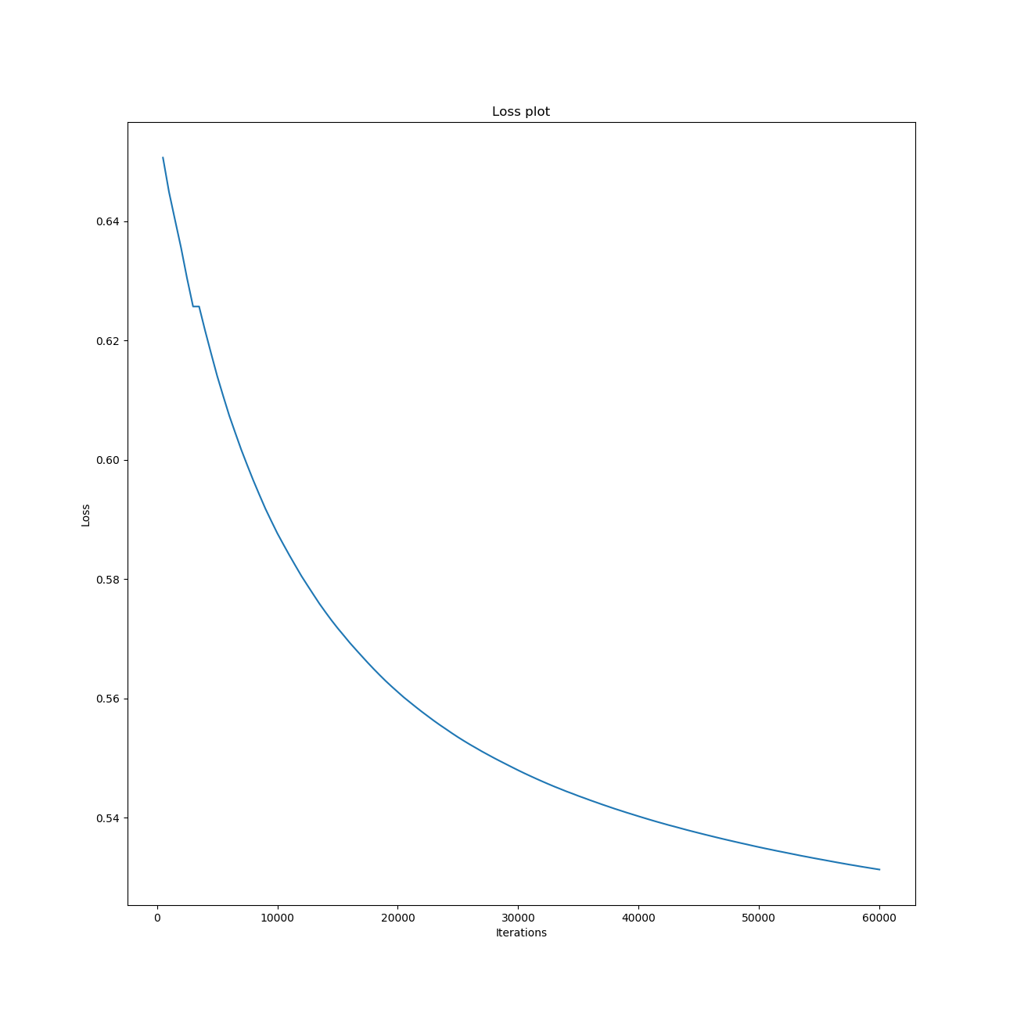
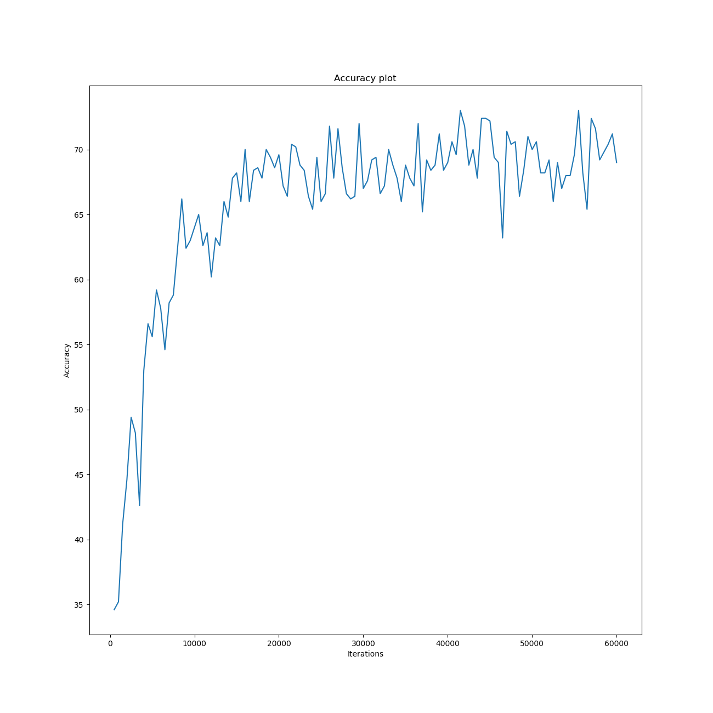
Our training results
After a grand total of 60000 iterations over our network, loss had drastically decreased, and accuracy had settled around the 70% mark

Slide 8
Testing the Network on the wild
Usually, there are two ways for testing Convolutional Neural Networks on the wild:
Closed Set, meaning that the Network will receive as an input images that are somehow known to the dataset (hence, to the network as well);
Open Set, meaning that our network could be tasked to also evaluate samples of users which are not registered in the dataset
Our focus will be on the Verification with Multiple Templates: this means that the network will have to make a match of a person against his/her stored templates on the dataset

Slide 9
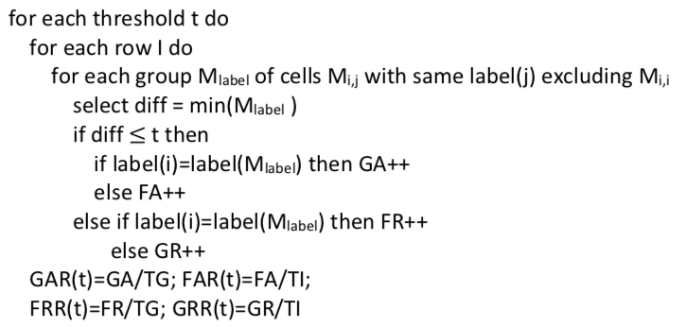
The operation will be implemented according to the «One vs All» procedure, so that it is possible to have a better accuracy value.

Slide 10
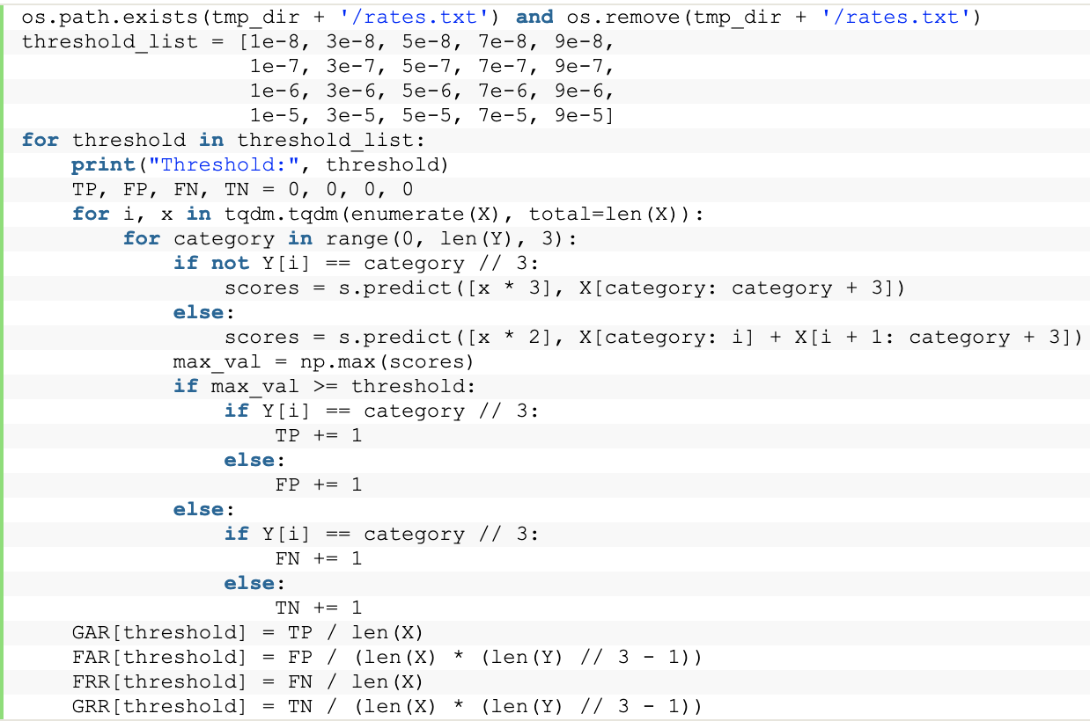
Python implementation of One vs All with Siameses Neural Networks

Slide 11
Algorithm’s explanation
By iterating on the test set, we take 3 images (3 of, say, a person X if X is not the person we are using to make the comparison; 2 otherwise) that will be compared to the one currently analyzed:
The Siamese Network will then perform its predictions
If one of these three predicted values are greater or equal to the current threshold, then it is safe to assume that we have a positive prediction.
This will be either true or false, based on the matching of the compared identities. The same holds true if the prediction is negative

Slide 12
AWS for more power
Since a consumer-grade computer would have taken a lot of time, we decided to use an AWS’s p2.xlarge instance
With this, the calculation took only 9 days instead of 20.
The specs of a p2.xlarge instance are as follows:
61GB of RAM
4 vCPUs
1 nVidia K80

Slide 13
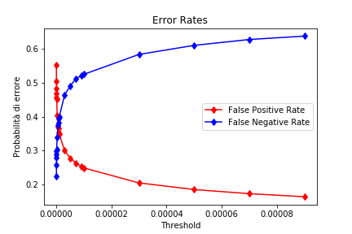
FAR and FRR mutation during time
After the calculations, this is how FAR and FRR evolves through time
Since we are using the One vs All Procedure, we need to find the E.R.R. which, according to the plot, is between 0.37 and 0.38

Slide 14
Conclusions
Adapted a network that was initially created for handwriting recognition to image recognition.
As for future work, it might be interesting to try to tweak the network in order to reach an accuracy value of 75%-80% or more.
Data augmentation to get more accuracy

